Slide 1
Cross-Verification of Power Results: Manual Calculations vs. Voltus Output
Ishaan Singhal
11/7/2025

Slide 2

Saving .rpt file format command
Saving the report of voltus calculations in “inst_pwr.rpt” file

Slide 3
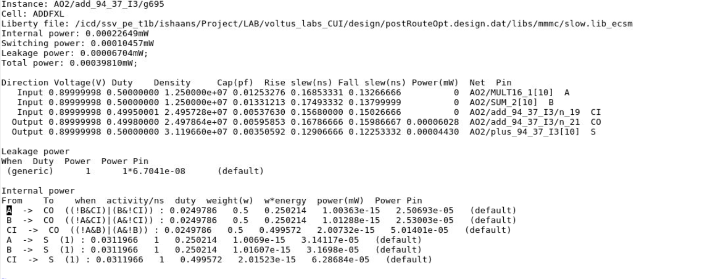


inst_pwr.rpt

Slide 4
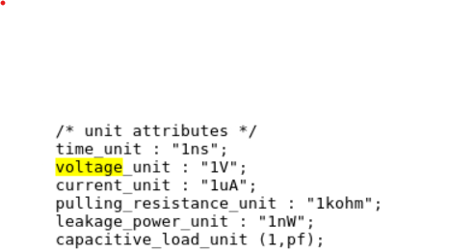
Units Specified in .lib File

Slide 5
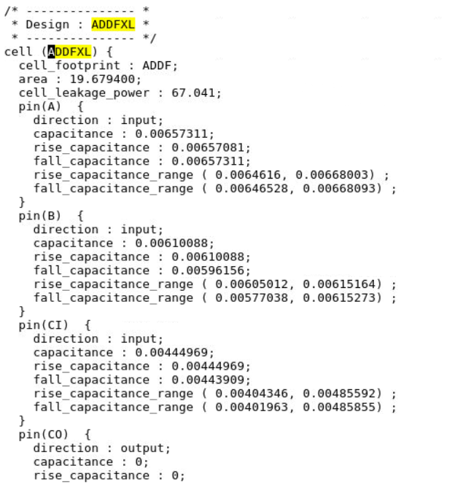



Leakage Power
Voltus Generated
.lib file
(nano-Watt)

Slide 6


Load Capacitance (cap of output)
.lib file
(pF)

Slide 7
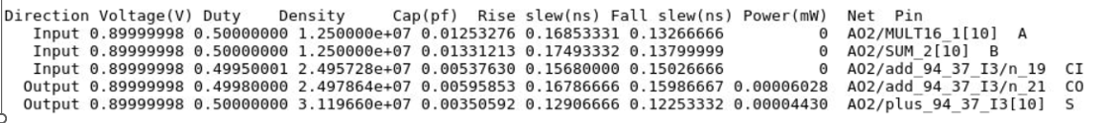





Switching Power for Output (CO)
Voltus Generated
Switching Power (P) = α × Cₗ × VDD² × f
P = Switching Power
α = Switching Activity (TR)
Cₗ = Load capacitance
VDD = Supply voltage
f = Clock frequency
Load cap(pF)
Switching power (manual Calculation) = 0.5 * (0.00595853 * 10^-9) * (0.9^2) * 2 =0.6033011625 μW

Slide 8

Switching Power for Output (S)
Voltus Generated
Switching Power (P) = α × Cₗ × VDD² × f
P = Switching Power
α = Switching Activity (TR)
Cₗ = Load capacitance
VDD = Supply voltage
f = Clock frequency
Load cap(pF)
Switching power (manual Calculation) = 0.5 * (0.00350592 * 10^-9) * (0.9^2) * 2.5 = 0.4438148 μW

Slide 9


Total Switching Power
Voltus Generated
Switching Power (P) = α × Cₗ × VDD² × f
P = Switching Power
α = Switching Activity (TR)
Cₗ = Load capacitance
VDD = Supply voltage
f = Clock frequency
Total Switching power (manual calculation) = 0.6033011625 μW + 0.4438148 μW = 1.0471159625 μW

Slide 10
Slew Normalisation
Rise slew
Fall slew

Slide 11

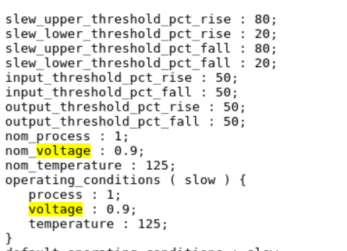

Slew Normalisation
Slew normalisation is given by

Slide 12
Slew Normalisation
Upper value = 80
Lower value = 20
Rise Slew | Fall Slew | Normalized Rise Slew | Normalized Fall Slew
0.16853331 | 0.13266666 | 0.28088885 | 0.22111110
0.17493332 | 0.13799999 | 0.29155553 | 0.22999998
0.15680000 | 0.15026666 | 0.26133333 | 0.25044443
0.16786666 | 0.15986667 | 0.27977777 | 0.26644445
0.12906666 | 0.12253332 | 0.21511110 | 0.20422220

Slide 13
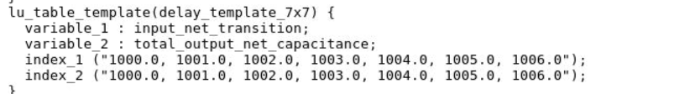





What index_1 and index_2 means

Slide 14
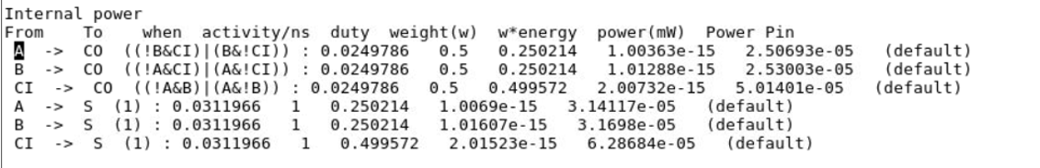
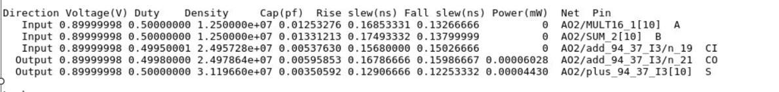









Internal Power Calculation
First three are for the output CO with their respected conditions
Last three are for the output S
Capacitances used for respected outputs

Slide 15
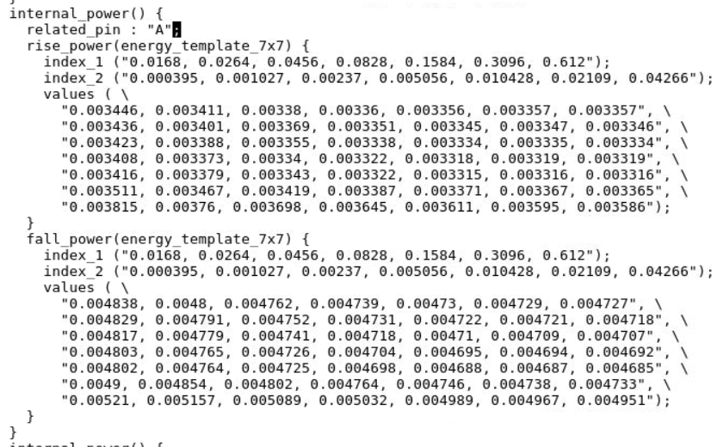



Internal Power for Input (A -> CO)
Rise Slew | Fall Slew | Normalized Rise Slew | Normalized Fall Slew
0.16853331 | 0.13266666 | 0.28088885 | 0.22111110
Capacitance = 0.00595853
Rise Energy = (0.003322 + 0.003315 + 0.003387 + 0.003371) / 4 = 0.00334875/1000nJ = 3.34875*10-15J
Fall Energy = (0.004698 + 0.004688 + 0.004764 + 0.004746 ) / 4 = 0.004724 / 1000 μJ = 4.724 × 10⁻¹⁵ J
Total Energy = (4.724 × 10⁻¹⁵ + 3.34875 × 10⁻¹⁵) / 2 = 4.036375 × 10⁻¹⁵ J
Internal Power = (activity/ns) * (w*energy)
Internal Power = (0.025e+9)*(0.250214)*4.036375 × 10⁻¹⁵ =
2.5248938356249997 × 10⁻⁸ W

Slide 16
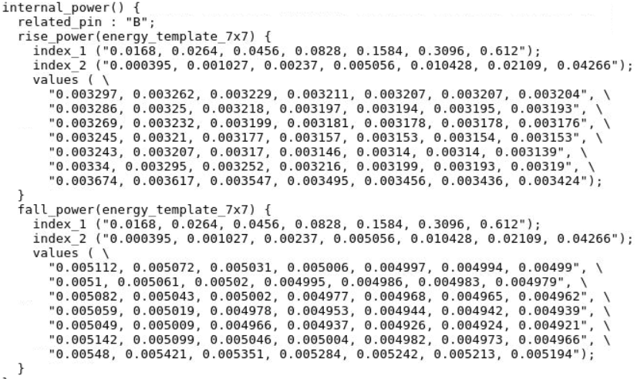

Internal Power for Input (B -> CO)
Rise Slew | Fall Slew | Normalized Rise Slew | Normalized Fall Slew
0.17493332 | 0.13799999 | 0.29155553 | 0.22999998
Capacitance = 0.00595853
Rise Energy = (0.003146 + 0.00314 + 0.003216 + 0.003199) / 4 = 0.00317525/1000nJ = 3.17525*10-15J
Fall Energy = = (0.004937 + 0.004926 + 0.005004 + 0.004982) / 4 = 0.00496225/ 1000 μJ = 4.96225 × 10⁻¹⁵ J
Total Energy = (3.17525× 10⁻¹⁵ + 4.96225 × 10⁻¹⁵) / 2 = 4.06875 × 10⁻¹⁵ J
Internal Power = (activity/ns) * (w*energy)
Internal Power =
(0.025e+9)*(0.250214)* 4.06875 × 10⁻¹⁵ =
2.54503308125 × 10⁻¹⁵ W

Slide 17
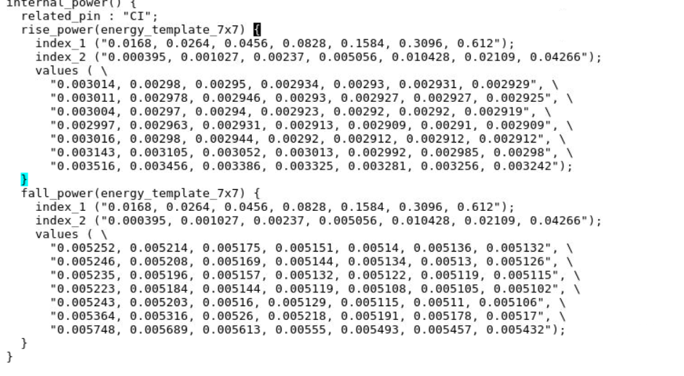


Internal Power for Input (CI -> CO)
Rise Slew | Fall Slew | Normalized Rise Slew | Normalized Fall Slew
0.15680000 | 0.15026666 | 0.26133333 | 0.25044443
Capacitance = 0.00595853
Rise Energy = (0.00292 + 0.002912 + 0.003013 + 0.002992) / 4 = 0.00295925/1000
= 2.95925*10-15J
Fall Energy = = (0.005129 + 0.005115 + 0.005218 + 0.005191) / 4 = 0.00516325 / 1000 μJ = 5.16325 × 10⁻¹⁵ J
Total Energy = (5.16325 × 10⁻¹⁵ + 2.95925 × 10⁻¹⁵) / 2 = 4.01625 × 10⁻¹⁵ J
Internal Power = (activity/ns) * (w*energy)
Internal Power = (0.025e+9)*(0.499572)*4.01625 × 10⁻¹⁵ =
5.01668801025 × 10⁻⁸ J

Slide 18
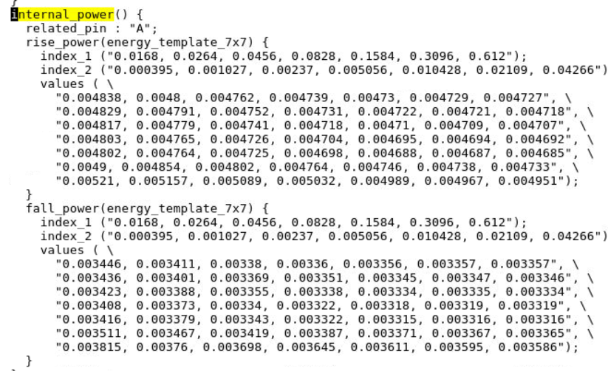



Internal Power for Input (A -> S)
Rise Slew | Fall Slew | Normalized Rise Slew | Normalized Fall Slew
0.16853331 | 0.13266666 | 0.28088885 | 0.22111110
Capacitance = 0.00350592
Rise Energy = (0.004725 + 0.004698 + 0.004802 + 0.004764) / 4= 0.00474725
/1000nJ = 4.74725*10-15J
Fall Energy = (0.003343 + 0.003322 + 0.003419 + 0.003387) / 4 = 0.00336775/ 1000 μJ =
3.336775 × 10⁻¹⁵ J
Total Energy = (4.74725 × 10⁻¹⁵ + 3.336775 × 10⁻¹⁵) / 2 = 4.0575 × 10⁻¹⁵ J
Internal Power = (activity/ns) * (w*energy)
Internal Power =
(0.0311966e+9)*(0.250214)* 4.0575 × 10⁻¹⁵ =
3.1672139288763 × 10⁻⁸ W

Slide 19
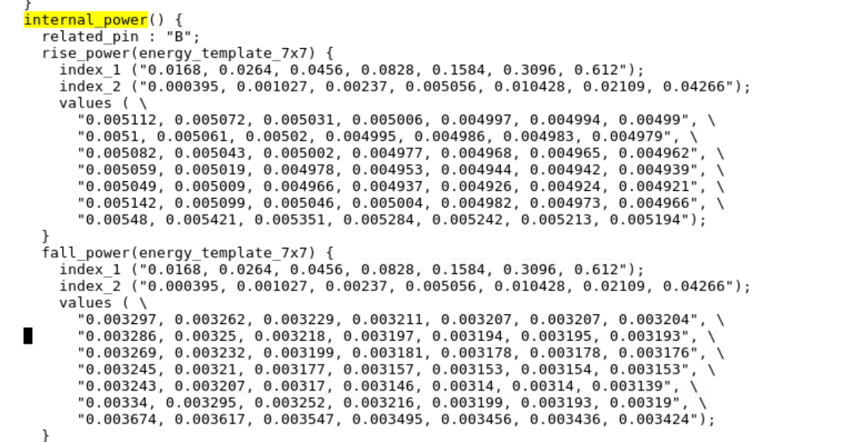

Internal Power for Input (B -> S)
Rise Slew | Fall Slew | Normalized Rise Slew | Normalized Fall Slew
0.17493332 | 0.13799999 | 0.29155553 | 0.22999998
Capacitance = 0.00350592
Rise Energy = (0.004966 + 0.004937 + 0.005046 + 0.005004) / 4 = 0.00498825/1000
4.98825 × 10⁻¹⁵ J
Fall Energy = (0.00317 + 0.003146 + 0.003252 + 0.003216) / 4 = 0.003196/ 1000 μJ =
3.196 × 10⁻¹⁵ J
Total Energy = (4.98825× 10⁻¹⁵ + 3.196 × 10⁻¹⁵) / 2 = 4.092125 × 10⁻¹⁵ J
Internal Power = (activity/ns) * (w*energy)
Internal Power =
(0. 0311966e+9)*(0.0250214)* 4.092125 × 10⁻¹⁵ =3.19142416016 × 10⁻¹⁵ W

Slide 20
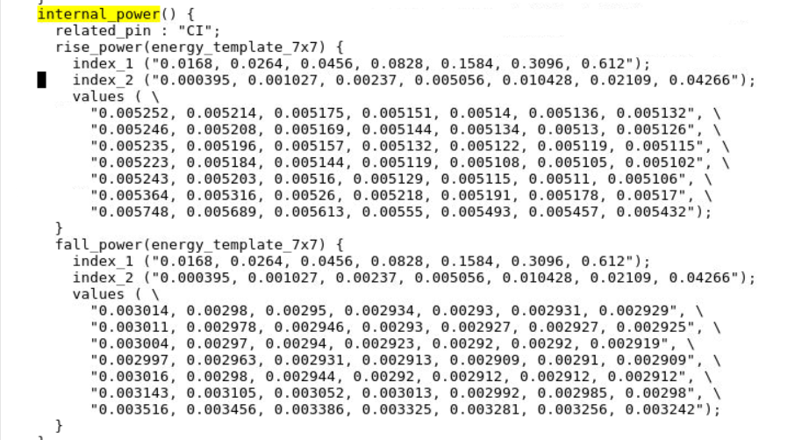
Internal Power for Input (CI -> S)
Rise Slew | Fall Slew | Normalized Rise Slew | Normalized Fall Slew
0.15680000 | 0.15026666 | 0.26133333 | 0.25044443
Capacitance = 0.00350592
Rise Energy (0.00516 + 0.005129 + 0.00526 + 0.005218) / 4 = 0.00519175 /1000
= 5.19175 × 10⁻¹⁵ J
Fall Energy = = (0.002944 + 0.00292 + 0.003052 + 0.003013) / 4 = 0.00298225 / 1000 μJ = 2.98225 × 10⁻¹⁵ J
Total Energy = (5.19175 × 10⁻¹⁵ + 2.98225 × 10⁻¹⁵) / 2 = 4.087 × 10⁻¹⁵ J
Internal Power = (activity/ns) * (w*energy)
Internal Power = (0.0311966e+9)*(0.499572)*4.087 × 10⁻¹⁵ =
6.36956818842 × 10⁻⁸ W

Slide 21
Total Internal Power
Internal Power for Input (A -> CO) + Internal Power for Input (B -> CO)
+ Internal Power for Input (CI -> CO) + Internal Power for Input (A -> S)
+ Internal Power for Input (B -> S) + Internal Power for Input (CI -> S)
2.5248938356249997 + 2.54503308125 + 5.01668801025 + 3.1672139288763 + 3.19142416016 + 6.36956818842
= 22.8148212046 × 10⁻⁸ W

Slide 22
Total Power
Total Leakage Power + Total Switching Power + Total Internal Power
0.00006704mw + 1.0471159625 μW + 22.8148212046 × 10⁻⁸W
= 0.00037138539688273736 mW

